Slide 1
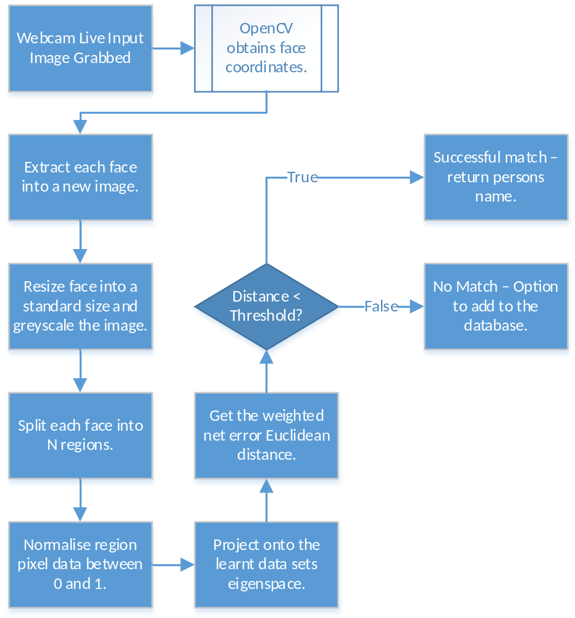
Dumbledore:
A Vision Based Attendance Analyser
Introduction
Dumbledore is a proof of concept for a vision based attendance analyser. The concept is a webcam can be placed in a lecture to monitor which students are present and absent, and then report the findings.
To achieve this the facial verification algorithms PCA[1] (principle component analysis) and WMPCA[2] (weighted modular principle component analysis) were implemented at a software level and tested.
Modules
The project is comprised of two primary modules – a graphical user interface (GUI) and a application program interface (API). The API was implemented such that it handles all the auditing, facial recognition and verification, while the GUI presents a front end prototype of the Dumbledore application. The GUI sends data to the API that processes it and returns information to render. During the testing of PCA and WMPCA a test project was utilised that only called the API as the GUI was not needed.
JavaFX[3] is used to power the GUI which provides a rich user interface following the model, view, controller (MVC) framework. OpenCV[4] is a image processing library used to detect the coordinates of faces within an image.
Webcam Live Input
The process taken from a live input image snapshot being obtained by the webcam to returning what people have been identified is shown in Figure 1. This process will return the peoples names who have been identified as in the lecture, and then the system can use this data to identify which students area absent and report it.
Table 1. Testing the University of Essex Facial Databases
Figure 1. The Webcam Process Live Input Process
Testing PCA and WMPCA
The University of Essex provides several facial databases of increasing difficulty[5] that were used to determine whether PCA and WMPCA are performing as required. Table 1 highlights the success of both algorithms at handling the databases. Faces96 is the database that has the greatest variation in pose and illumination and subsequently proves to be the hardest to learn, however WMPCA still provides a good match rate at 68.59%. These tests were run with number of regions set to three and 80% of the principle components being used. The standard size of the faces was set to 50x50 pixels.
References
M. Turk, A. Pentland, “Eigenfaces for Recognition”, [Online] http://www.face-rec.org/algorithms/PCA/jcn.pdf
A. P. Kumar, S. Das, V. Kamakoti, “Face Recognition using Weighted Modular Principle Component Analysis”, [Online] http://www.cse.iitm.ac.in/~vplab/publi_journal/conference/IP_028_239.pdf
Oracle, “JavaFX – The Rich Client Platform”, [Online] http://www.oracle.com/technetwork/java/javase/overview/javafx-overview-2158620.html
OpenCV, “Open Source Computer Vision”, [Online] http://opencv.org/
L. Spacek, “Computer Vision Science Research Projects”, (20/06/2008), [Online] http://cswww.essex.ac.uk/mv/allfaces/index.html
Acknowledgements
M. Manjunathiah for project supervision and guidance.
Database | Algorithm | Threshold | Success Rate
Faces94 | PCA | 45 | 93.37%
Faces94 | WMPCA | 15 | 99.16%
Faces95 | PCA | 40 | 91.6%
Faces95 | WMPCA | 10 | 95.83%
Faces96 | PCA | 35 | 60.99%
Faces96 | WMPCA | 9 | 68.59%
Grimace | PCA | 13 | 78.33%
Grimace | WMPCA | 9 | 95%
Degree programme
BSc Computer Science

